Slide 1

DATA ANALYSIS ON BOX OFFICE COLLECTIONS
of
DOCUMENTARIES

Slide 2
About us
Keerthi Guddeti
Bsc. computers
Manjo Muttineni
MBA

Slide 3
WEB SCRAPPING AND THE CHALLENGES FACED:
Website – www.boxofficemojo.com
Data Collection
Website Server Responses
Column with same tag names(no. of theaters)
Accessing the inner data from hrefs

Slide 4
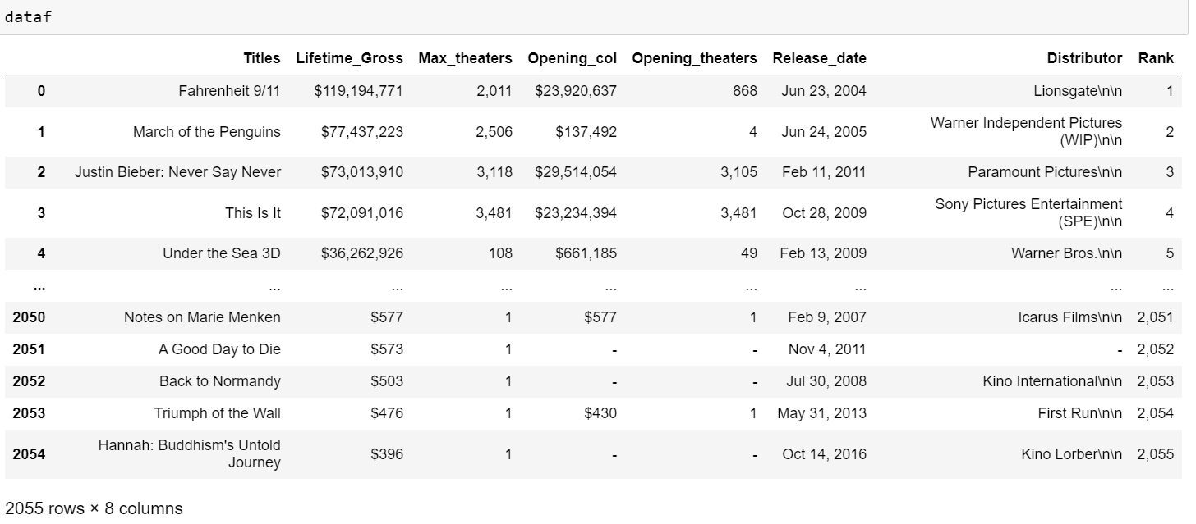
Raw Data :

Slide 5
DATA CLEANING STEPS ::
Changing column data types
Removing special characters and converting dtypes
Replacing ‘-’ with Nulls and removing Nulls.
Removing extra characters from distributors column
Changing the release date column into datetime dtype
Final Data Structure – Shape(1696,8)

Slide 6
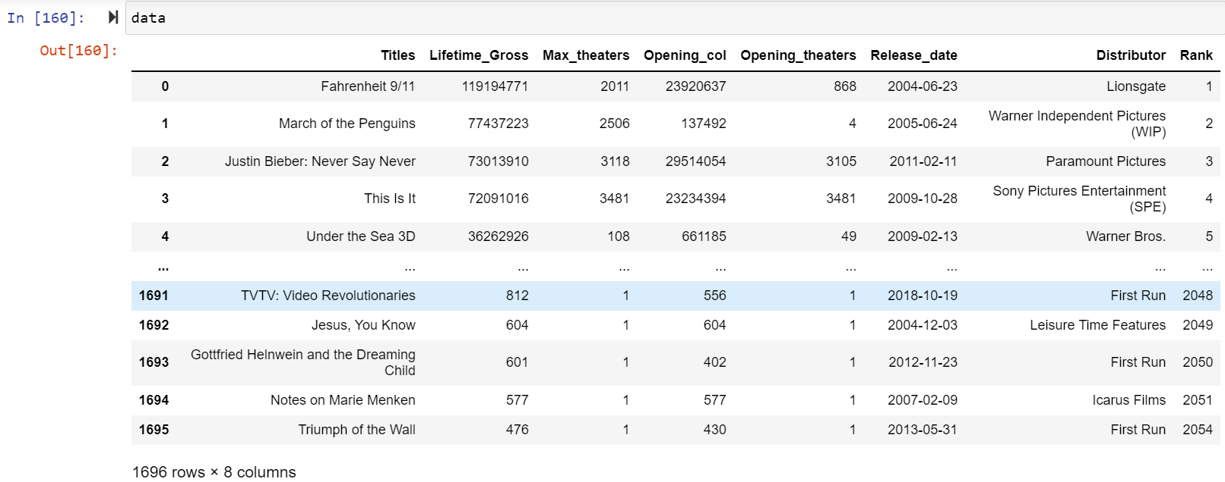
Final Data after cleaning :

Slide 7
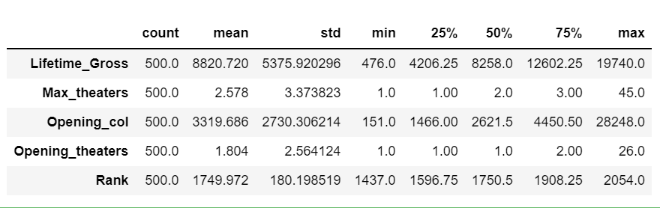
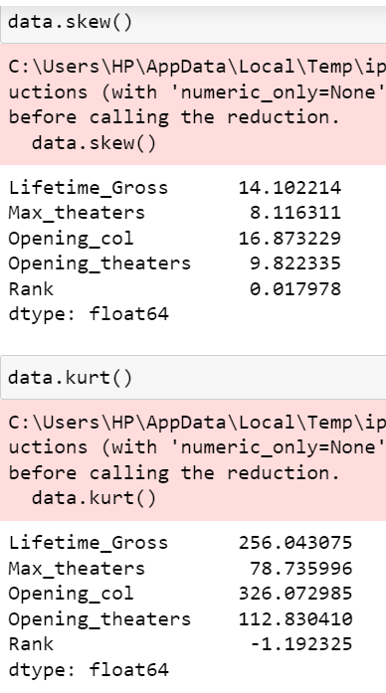


Univariate Analysis :

Slide 8
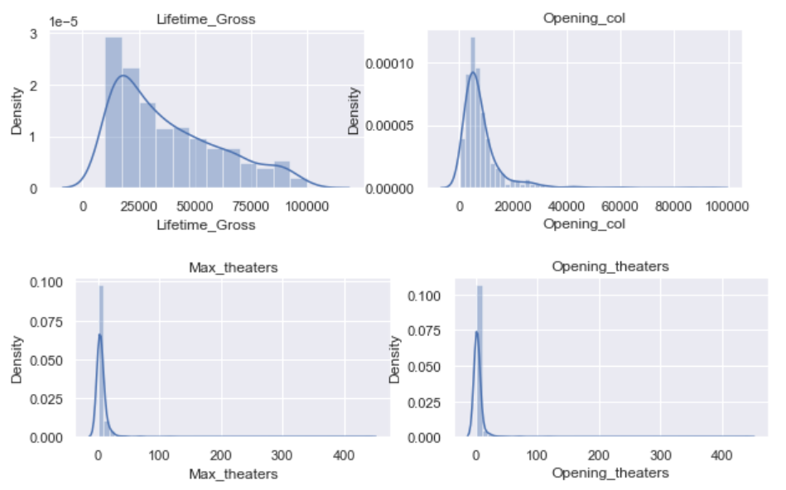
Distribution of data after removing outliers:

Slide 9
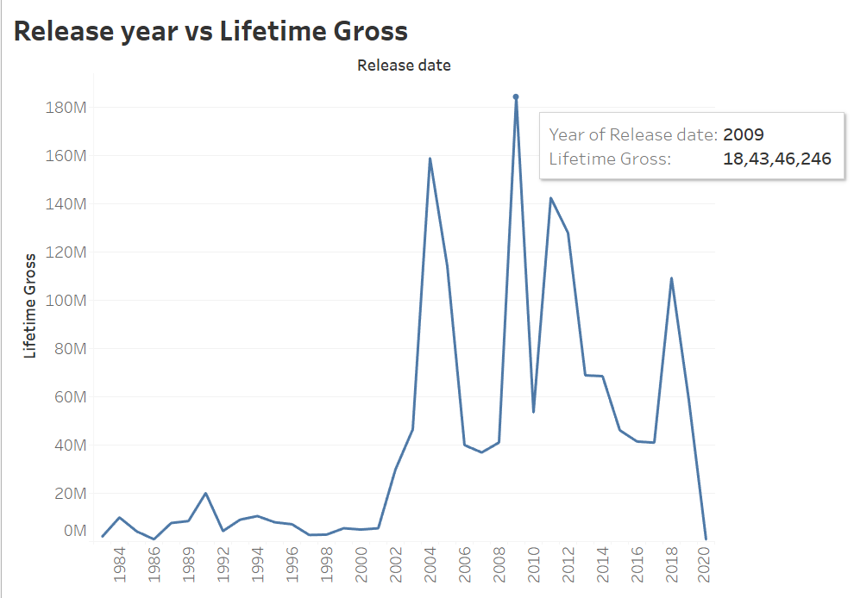
Bivariate Analysis:
in 2009 the lifetime gross is 18,43,46,246

Slide 10
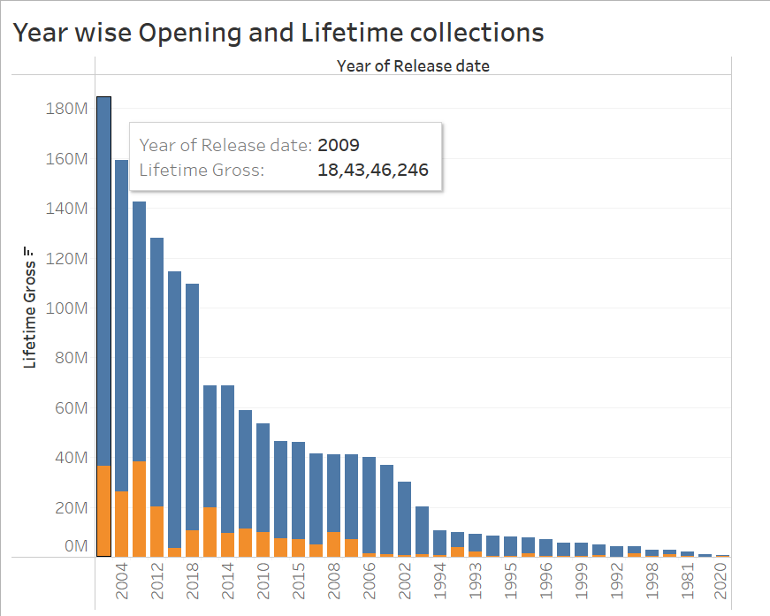
Bivariate Analysis:
2009 is the highest life time collections

Slide 11
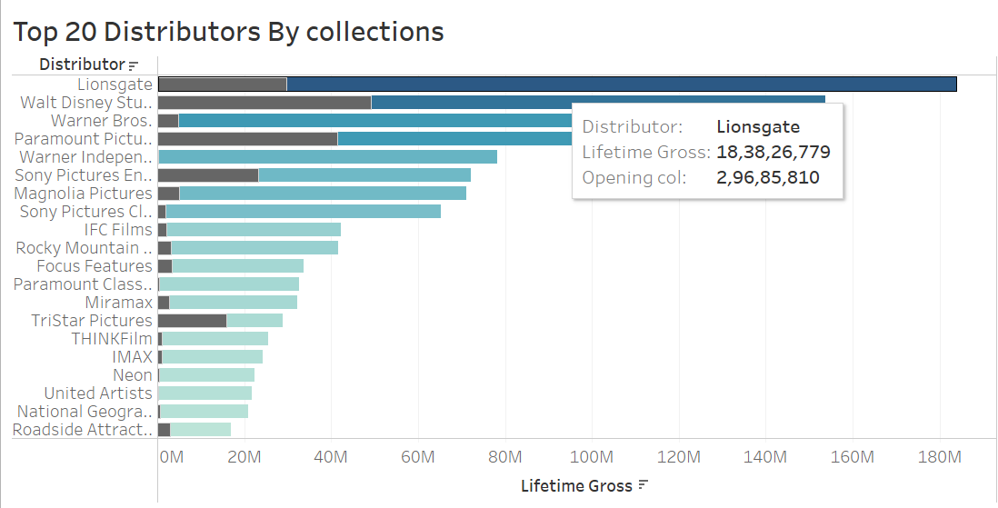
Bivariate Analysis:
The higest distributors is “Lionsgate”

Slide 12
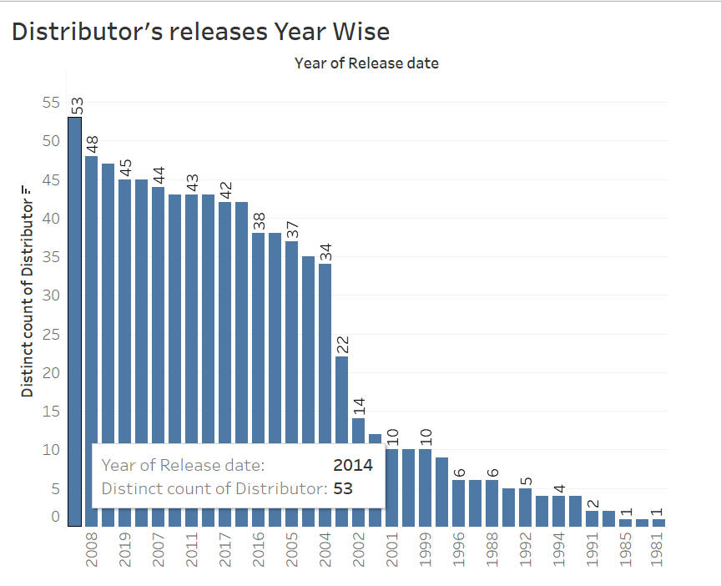
Bivariate Analysis:
In 2014 is the higest distributors are releases .
The count of distinct distributor is 53

Slide 13
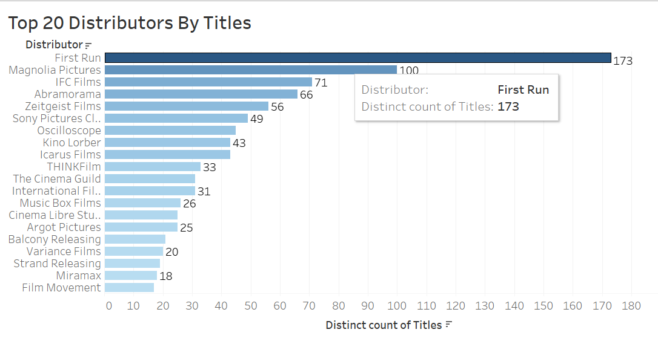
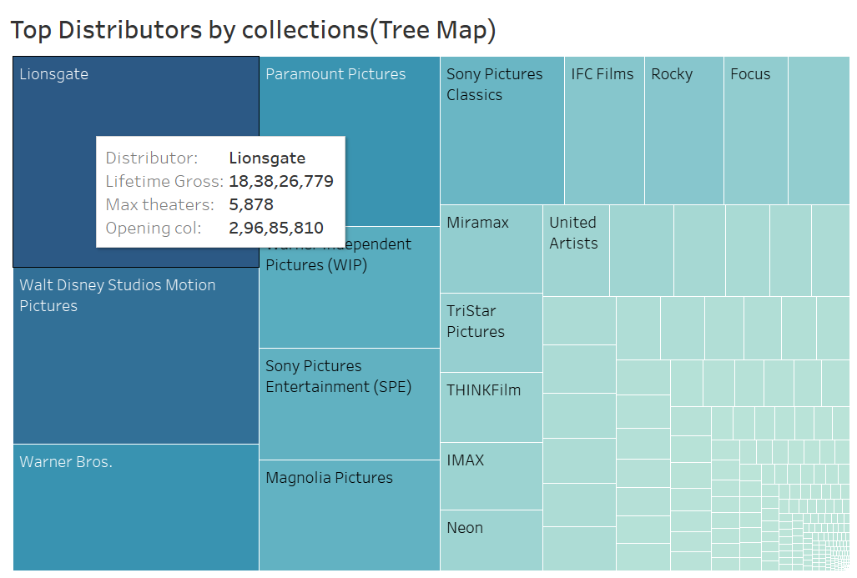
Bivariate Analysis:
The top distributor is “First Run”
The distinct count of titles is 173

Slide 14
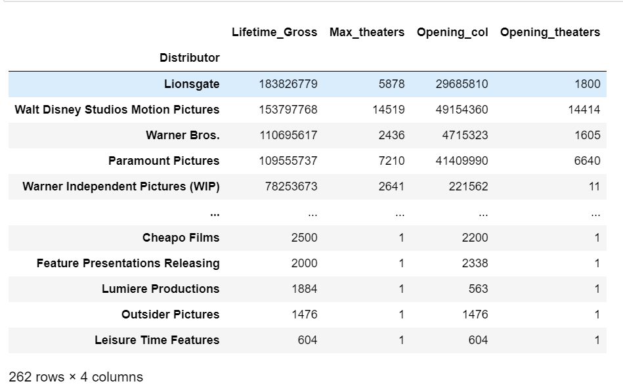
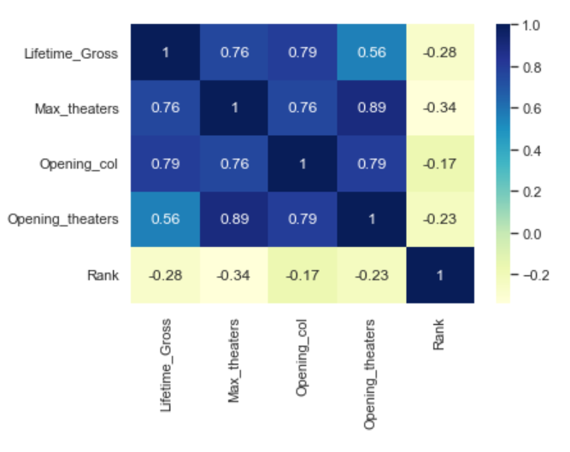
Multivariate Analysis:

Slide 15
Conclusion
Data contains lots of Outliers that we can guess by intuition as we know movie collections are uncertain.
Major documentaries have box office collection ranging from 0.01M to 1M
Max documentaries are released by the distributor First run i.e., 173 documentaries.
Lifetime Gross of documentaries was consistent up to 2000’s but got a sudden peak afterwards and decreased by 2020 as Covid impacts
Lionsgate Distributors has the highest lifetime gross value were as walt Disney has highest opening collections.
In the year 2009, The lifetime Gross collections were highest with 45 documentaries releases.
In the year 2014, the number of documentaries released is 53 which is all time highest in the given span.

Slide 16

THANK YOU

